Slide 1

google Gemini
Vladislav zolotukhin
Notes:
Hello and welcome to an introduction of the Google Gemini AI Model. In this presentation the concept and functionality of what an artificial intelligence (or AI) model is will be briefly elaborated upon, focusing specifically on Google Gemini in the context of how it may be of assistance to the Canadian Army. This won’t be a technical guide on how to train or use artificial intelligence, but it will briefly touch upon some technical aspects to describe the general principles and methodology behind how it works and processes information. No technical experience or background is required as a pre-requisite to understanding the material presented here as serves an introductory purpose for the topic.

Slide 2
What is an ai model?
Program trained on a set of data for pattern recognition and decision making without human intervention
Autonomously make predictions or decisions and apply different algorithms to a dataset to achieve their intended purpose
Learn from experience, more training data = better predictions and decisions
Notes:
So Google Gemini is AI, it’s a family of multimodal AI models actually, but what does that mean? What is an AI model? Simply put, it’s a program trained on a huge amount of data to recognize patterns and make decisions without requiring human intervention. Instead it autonomously predicts or decides based on applying different algorithms to a dataset to achieve its intended purpose. It is capable of machine learning, it learns from experience, and the more training data its provided the better it gets at making these predictions and decisions. Think of it like a recipe book, if its provided lots of different recipes, it can start to make deductions about what makes foods taste good and make assumptions about what ingredients may work well together even for recipes that its never seen before. In essence its conceptually fairly similar to a human learning from experience. They can be used to break down complex tasks, reason, problem solve and generate information, even optimize their own performance over time. In order to dive a little deeper, some definitions have to be made in the context of this topic. An algorithm is a procedure, a step-by-step series of instructions applied to a dataset to perform a certain function or achieve a purpose. Its like a process of telling a system how to do something. A practical example of this would be like following a recipe. Models are the output of an algorithm that has been applied to a dataset, they’re the end results, representations of patterns and relationships of what the AI system has learned and can use to make predictions or decisions. It’s specific to the data that it was trained on, like a trained neural network that can recognize specific images. Artificial Intelligence here is also a very broad term that encompasses different types of models with their own sets of processes and techniques for performing human-like cognition.

Slide 3


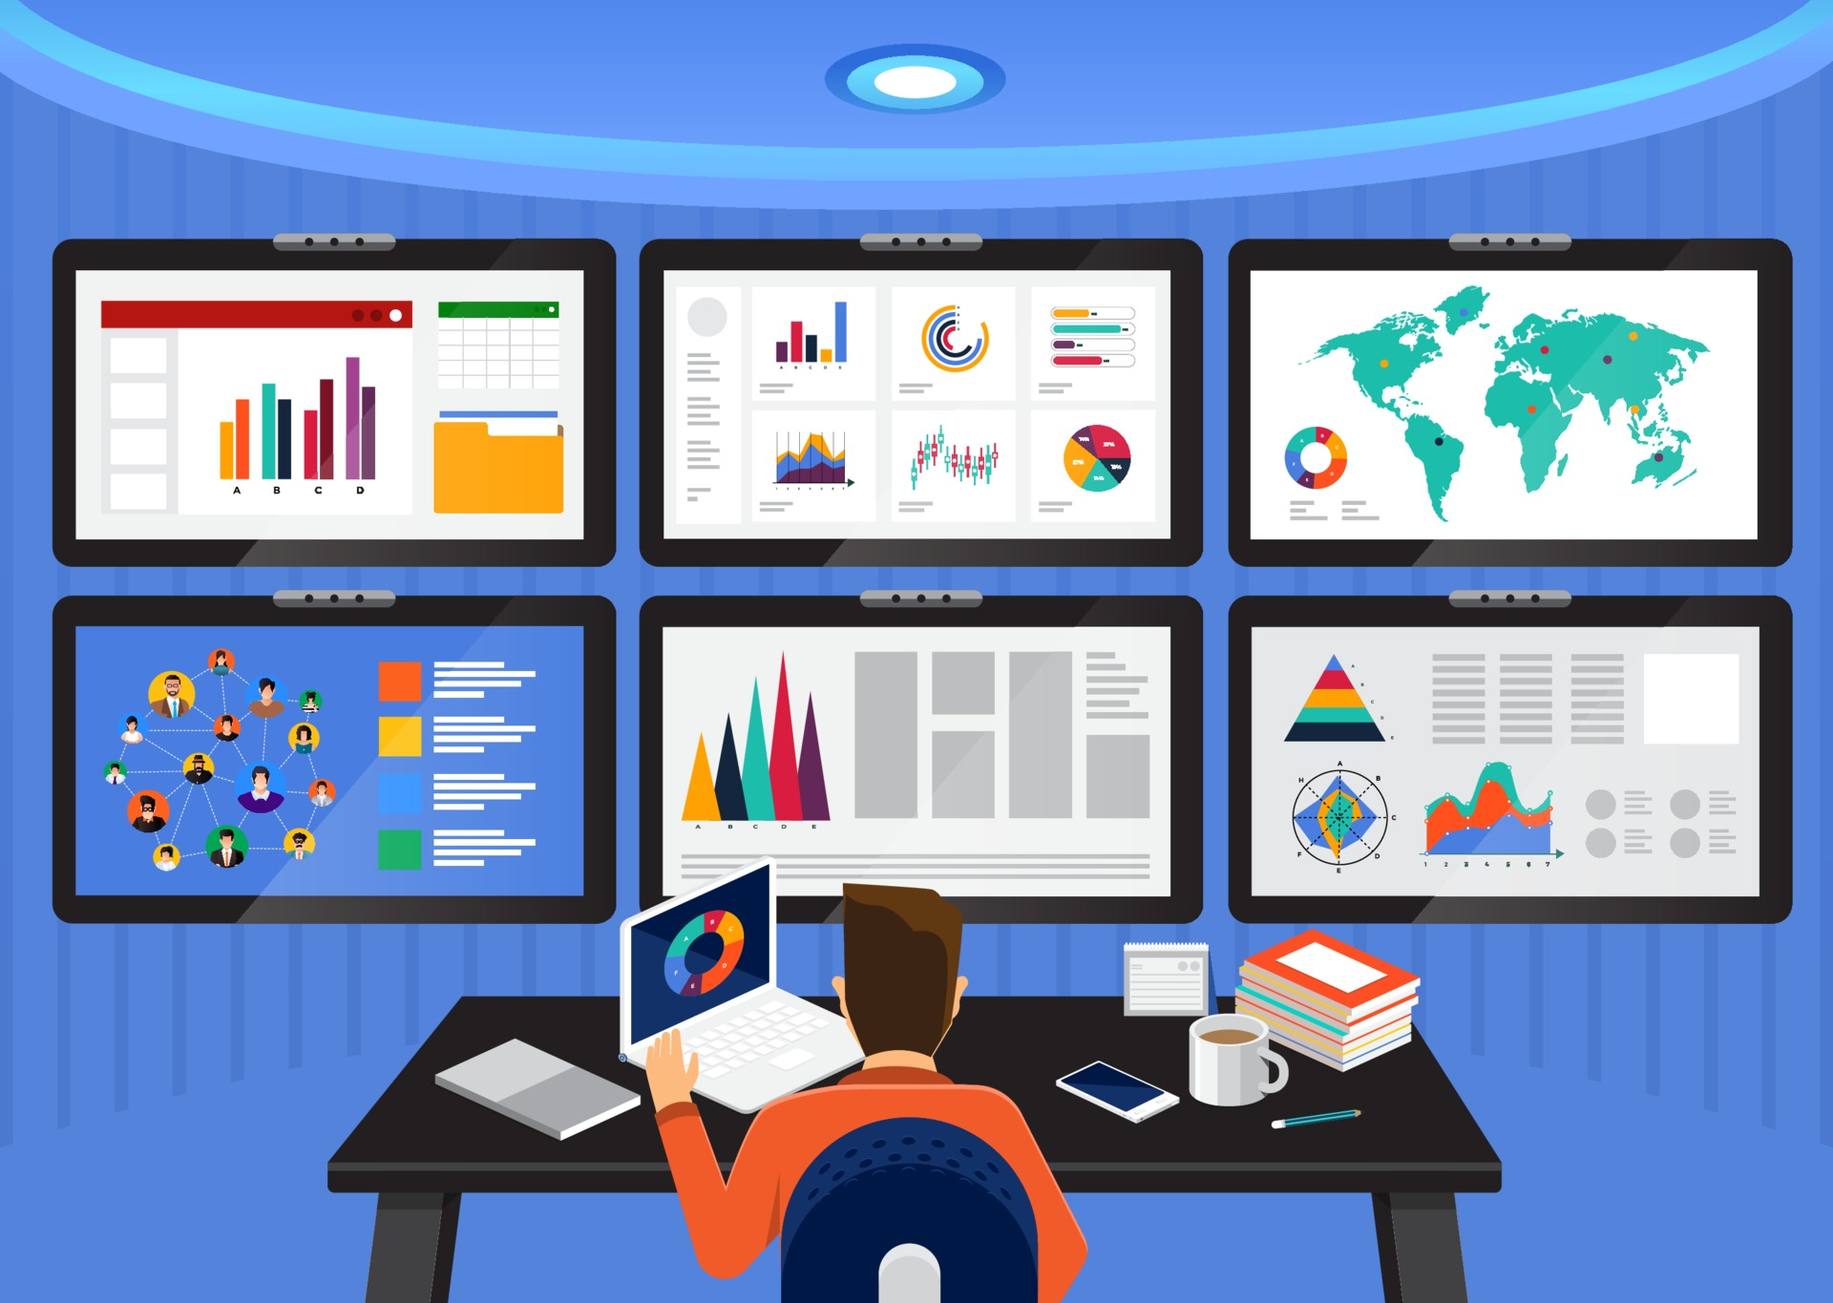
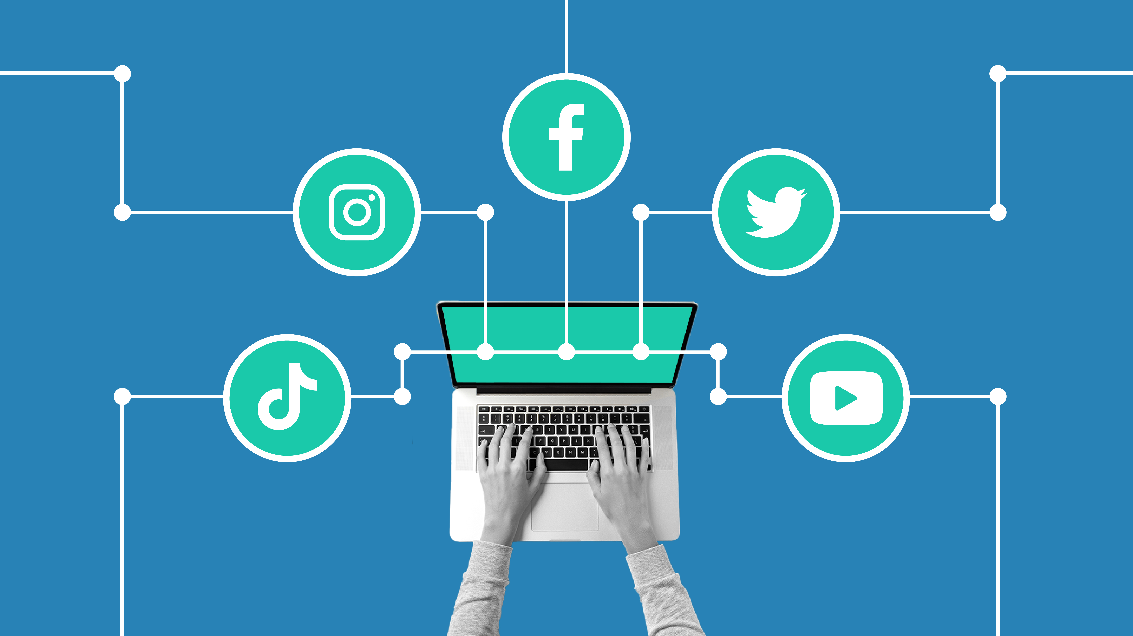
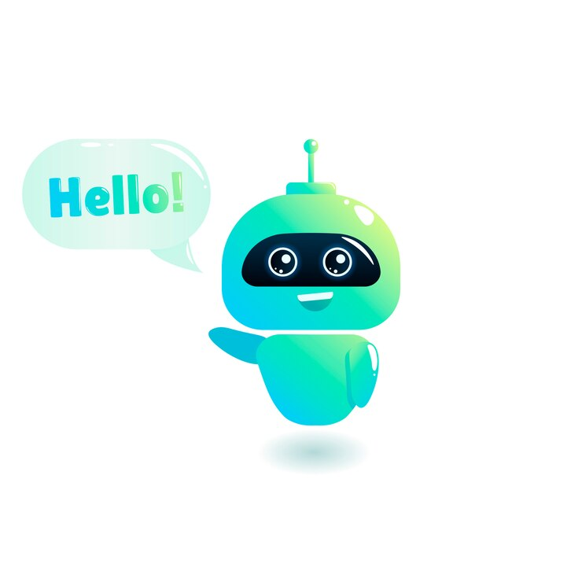
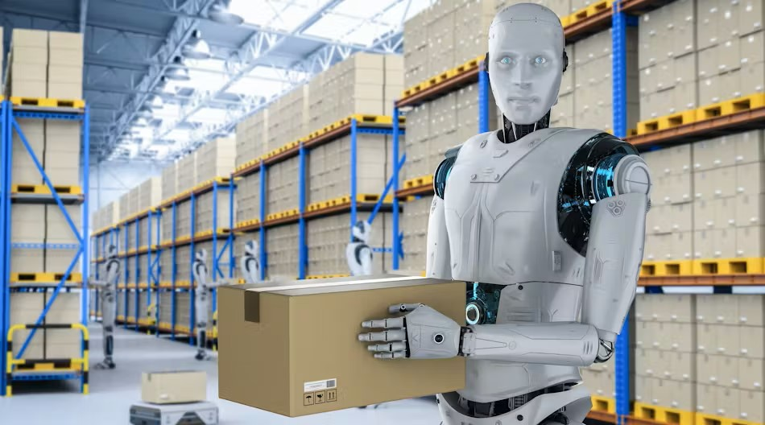
What can ai models be used for?
Large Language Models (LLMs) /Generative AI: Respond to a prompt and generate an inference, write essays, summarize information, translation, retrieval, chatbots/customer support, digital assistants
Analysis, collection, and visualization of data.
AI algorithms in media
AI-created media
Robots
Notes:
In the last few years, AI models have increasingly permeated our day to day lives due to the wide range of tasks they can be applied towards. They can be used to generate answers to questions by responding to prompts, drawing on the knowledge of their training to predict the next most likely words in a sequence and respond with human-like answers, known as inference. This can even be used to write essays, identify named entities such as places and people mentioned in a text, and summarize, translate, or retrieve information, or communicate back and forth with humans in a pre-defined manner such as a chatbots or a customer support. They can analyze and visually represent data to convey it in a more understandable format, be used as search engines or digital assistants such as Siri (Apple) or Alexa (Google). They are frequently used in social media, in fact all major social media platforms run off AI algorithms to curate the contents that you see by making a determination of what you like and serving more of that content to drive user engagement. If you click on a cooking video on YouTube, your video feed might suddenly become populated by cooking channels because the algorithm makes a reasonable assumption that this type of content will continue to keep you engaged with the platform. When you buy something from Amazon for example, an algorithm will show you related products to encourage you to spend more money through the app. Recently, AI is being used more frequently to generate media such as art, music, and even realistic videos. AI is also being used in robots in a variety of different field, from handling repetitive warehouse automation to tasks deemed too dangerous for humans to carry out, interacting with humans in workplace settings like mixing drinks or delivering meals in the hospitality industry, to even landing on different planets and collecting samples for study.
Image Sources: Chatbot image designed by Freepik (https://www.freepik.com), <a href="https://www.vecteezy.com/free-vector/data-visualization">Data Visualization Vectors by Vecteezy</a>, Quickframe (https://quickframe.com/blog/how-do-social-media-algorithms-work/), DeepAI & Adobe Firefly

Slide 4
Google Gemini
Result of large-scale collaborative effort from multiple teams working together across Google.
Released December 06, 2023
Multimodal
Gemini Ultra, Gemini Pro, Gemini Nano
Understand complex written and visual information.
Free to use
Notes:
We just covered only a few of the current use cases for AI modles in general, but what about Google Gemini? Gemini is the product of a large scale collaborative effort from multiple teams working together across Google. It was released on the 6th of December, 2023, and built ground-up to be multimodal, which means it can generalize and seamlessly understand, operate across and combine different types of information including text, code, audio, image and video. 3 different versions were released, Gemini Ultra is the largest and most capable model for handling complex tasks. It outperformed not only competing AI models such as ChatGPT 4 in a wide variety of benchmarks such as reasoning and math, but even became the first model to outperform human experts in being evaluated for problem solving and world knowledge skills within a combination of over 50 different subjects including math, physics, medicine, law, and ethics. Gemini Pro is the middle tier model, which is what currently powers Google Gemini, and is the best scaled across a wide range of tasks. Nano is the most lightweight version and also the most efficient, designed to run directly on mobile devices. All of these versions contain sophisticated reasoning capabilities, able to decipher combinations of different types of information to extract underlying insights and nuance. It’s also free to use, although a premium tier is also available.

Slide 5
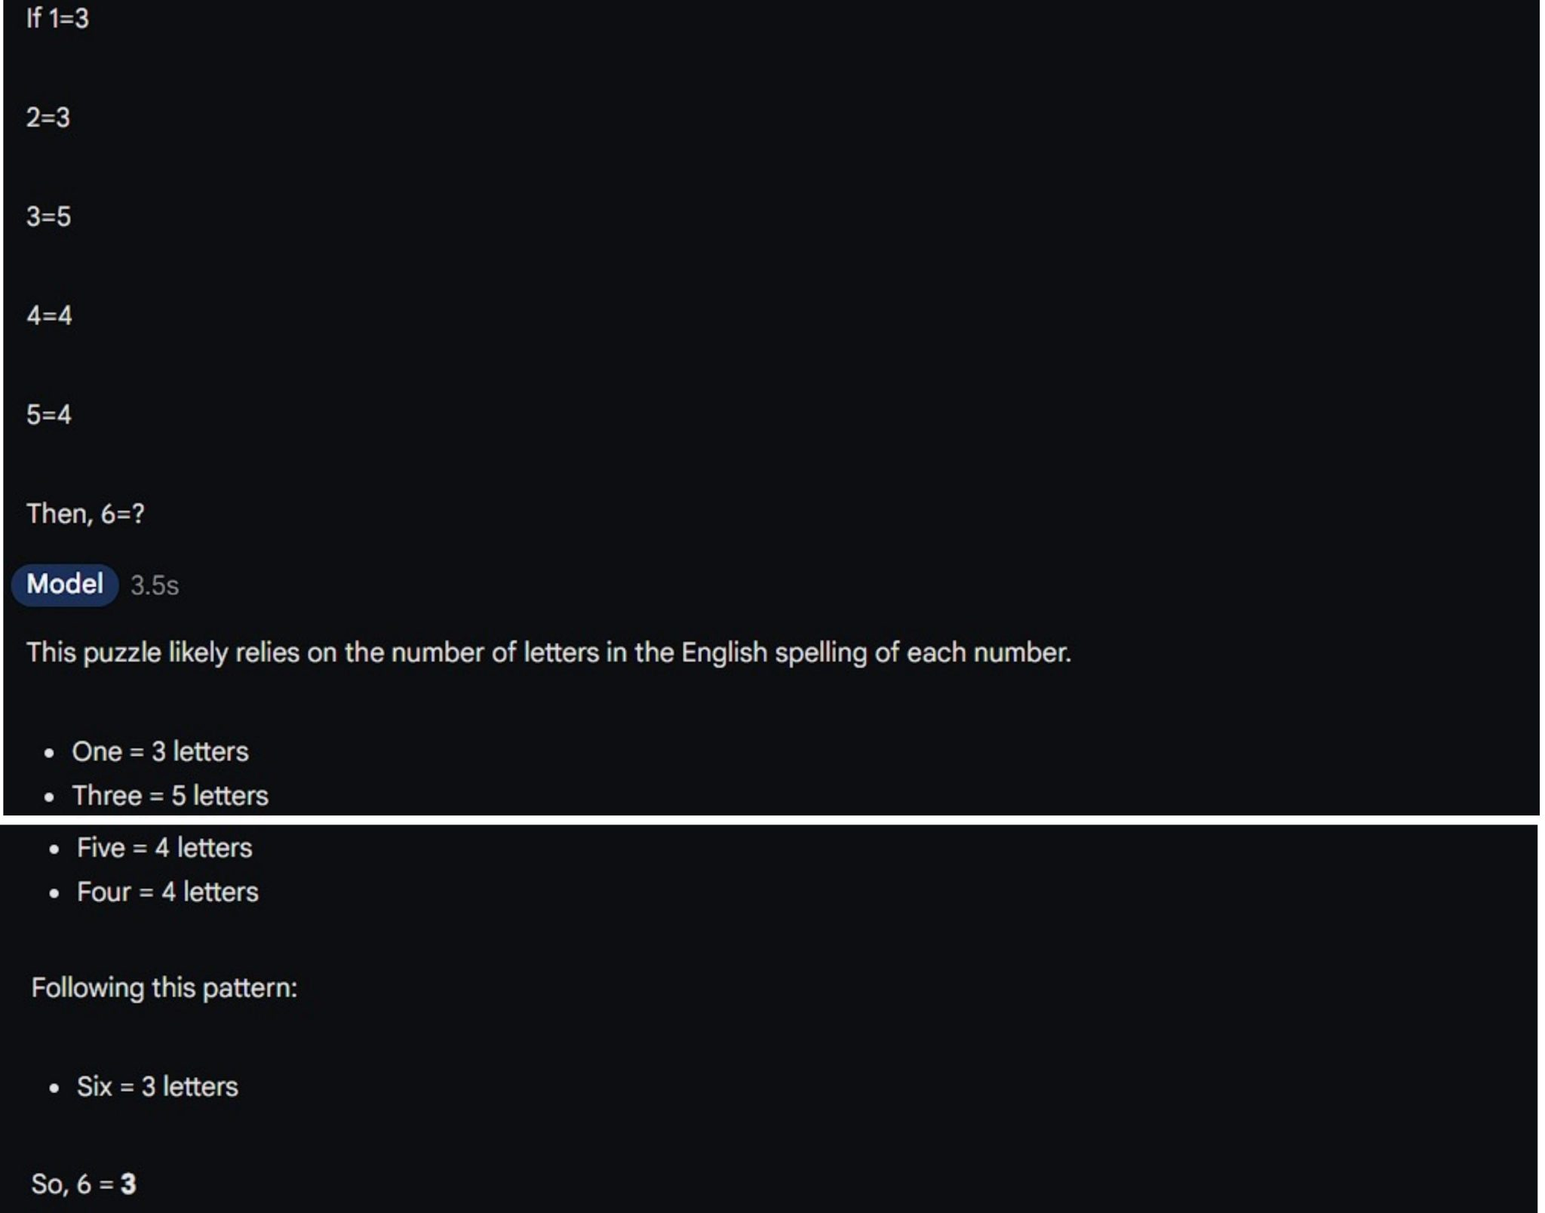
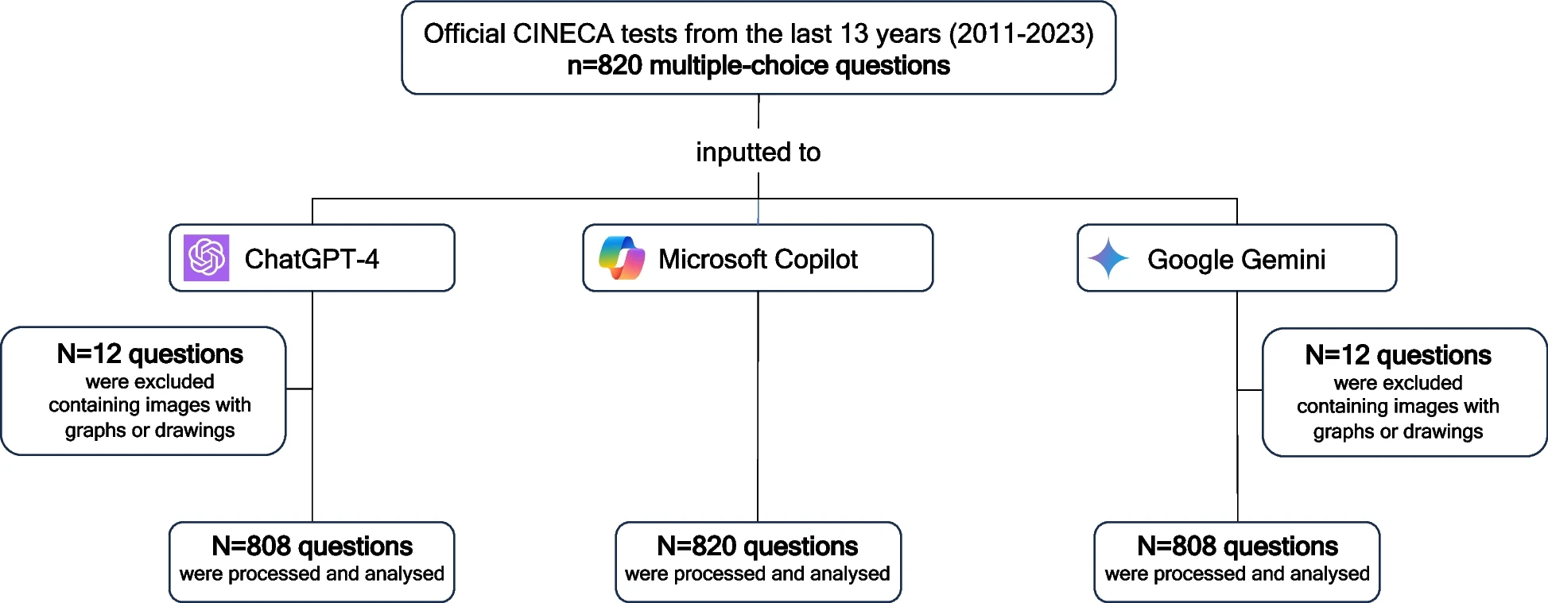
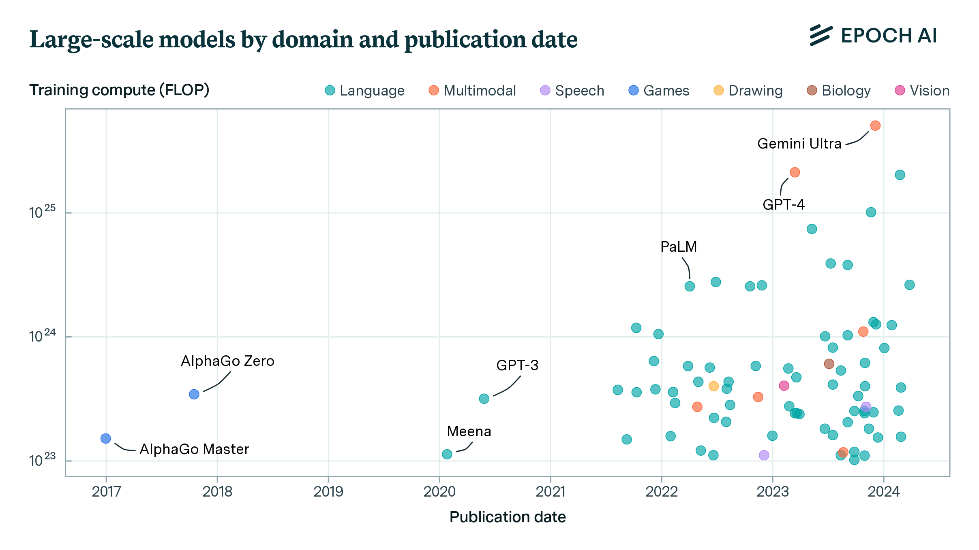
How does it compare?
Notes:
It’s really difficult to compare the efficiency of Gemini with its close competitors like ChatGPT and Copilot because of their complexity and the amount of tasks they can perform. However we can make some quantitative comparisons and here this chart gets a bit too technical so we won’t really get into that but some context is needed here. The measurement is in FLOPS which stands for Floating Point Operations, is basically a metric that quantifies the computational capacity and efficiency of AI systems, measuring prowess and processing speed and indicating a benchmark for assessing their performance. The graph shown here tracks AI models with over 10 to the power of 23 floating point operations, which corresponds to training costs of at least hundreds of thousands of dollars, identifying 81 models that meet the criteria and denoting the categories of these models, which by far are language models but include some multimodal models such as Gemini and GPT4, with Gemini clearly being the largest. Things that influence the size include the amount of parameters of a model, which are like adjustable dials that control how a model behaves and turns input into output, like variables in the digital space or knobs and levers on a physical machine, and the training data used to teach the model. However this doesn’t just mean that bigger is necessarily better, another study published on the 26th of June 2024 compared the accuracy of GPT-4, Copilot and Google Gemini in the Italian entrance test for healthcare science degrees and found statistically significant differences in the models, with Copilot and ChatGPT4 performing better than Gemini, although all 3 managed to perform well. Other studies have compared the models’ abilities in generating code to solve data structures and algorithms questions, solving tricky math problems, generating creative output, applying common sense, identifying movie names based on a single provided image, and asking general knowledge questions. Some models like GPT4 provided better or more meaningful and thought-out answers for general knowledge questions and logical reasoning, for example when asked what color a red balls turns into after being thrown in water GPT-4o correctly responds that it remains red, while Gemini asserted that the ball turned wet. However in other areas like solving tricky math problems, Gemini was more likely to answer correctly while ChatGPT would be completely misunderstand the problem.

Slide 6
Can Gemini assist the Canadian army?
Highly adaptable, can be trained for various purposes
Text, image, video processing used in automated visual detection
Predictive Analysis
Flexible AI Assistant
Automation
Notes:
Although there are still limitations and challenges that face Google Gemini, its adoption would nevertheless be an overall positive for the Canadian Army as there are numerous viable use cases for it. Firstly, we discussed how AI is highly flexible and can be trained to suit a variety of purposes. It can optimize its own performance over time and learn to improve its capabilities, making It highly adaptable. A multimodal model like Gemini that can process different information such as text, images, or videos could be used to process real time data such as thermal sensors, radar and lidar. It can identify and distinguish between different objects in live video feeds to assess various data and detect potential dangers. It can make predictive analysis based on the historical and simulated data it was trained on to support decision making. It can serve as a flexible AI assistant for retrieving or summarizing sensitive data or helping with the implementation of critical features. Or it could provide basic training using its knowledge base across a variety of different topics, whether they are technology related or something else. It can also greatly benefit in the automation and optimization of different aspects of the army such as record keeping, document translations, logistics, and maintenance. However, there are also concerns regarding potential security risks in implementing Google Gemini, since classified data could potentially be compromised and stolen by malicious users, the output provided by the models is currently not entirely reliable or free of bias, and it may encourage human errors like oversight and overreliance on the AI model. Overall, Google Gemini would be an asset in the Canadian Army, albeit in a limited and specific capacity to assist and augment aspects of the military with careful regard to its implementation rather than replace them.

Slide 7
Thank you
Ai inference vs. training: What is ai inference? | cloudflare. (n.d.). https://www.cloudflare.com/learning/ai/inference-vs-training/
AI models: What they are and how they work (with examples). Snowflake. (n.d.). https://www.snowflake.com/guides/ai-models-what-they-are-and-how-they-work/
Everyday examples and applications of Artificial Intelligence (AI). Tableau. (n.d.). https://www.tableau.com/data-insights/ai/examples
Gemini Ultra vs Gemini Pro vs Gemini Nano: Google’s Gemini versions explained. Android Authority. (2025, February 4). https://www.androidauthority.com/gemini-ultra-vs-gemini-pro-vs-gemini-nano-3392135/
Gemini. Google DeepMind. (n.d.). https://deepmind.google/technologies/gemini/
Google. (n.d.). Applications of artificial intelligence (AI) | google cloud. Google. https://cloud.google.com/discover/ai-applications
GPT-4O vs Gemini 1.5 Pro: Battle of the best AI of 2024. FavTutor Articles. (2024, May 26). https://favtutor.com/articles/gpt-4o-vs-gemini-1-5-pro/
Ibm. (2024, December 19). What is an AI model?. IBM. https://www.ibm.com/think/topics/ai-model#:~:text=An%20AI%20model%20is%20a,they’ve%20been%20programmed%20for.
Ibm. (2025, January 27). What are large language models (llms)?. IBM. https://www.ibm.com/think/topics/large-language-models
Klingler, N. (2025, January 31). The Ultimate Guide to AI models (2025). viso.ai. https://viso.ai/deep-learning/ml-ai-models/
Lark Editorial Team. (2023, December 25). Flops. Lark. https://www.larksuite.com/en_us/topics/ai-glossary/flops
LLM parameters guide. LLM Parameters Guide. (n.d.). https://www.vellum.ai/llm-parameters-guide
Rahman, R., Owen, D., & You, J. (2024, April 5). Tracking large-scale AI models. Epoch AI. https://epoch.ai/blog/tracking-large-scale-ai-models
Rossettini, G., Rodeghiero, L., Corradi, F., Cook, C., Pillastrini, P., Turolla, A., Castellini, G., Chiappinotto, S., Gianola, S., & Palese, A. (2024, June 26). Comparative accuracy of CHATGPT-4, Microsoft Copilot and Google Gemini in the Italian entrance test for Healthcare Sciences degrees: A cross-sectional study - BMC Medical Education. BioMed Central. https://bmcmededuc.biomedcentral.com/articles/10.1186/s12909-024-05630-9
staff, M. (2024, February 6). Warehouse robot market to increase 25% by 2030. Material Handling and Logistics. https://www.mhlnews.com/technology-automation/article/21282102/warehouse-robot-market-to-increase-25-y-2030
Notes:
This concludes my presentation on Google Gemini in the context of the Canadian Army. I hope it provided some insight into the nature of AI models and how they can benefit us through a grounded and understandable manner. If you wish to learn more about any of the topics or studies covered here, click on the corresponding citations on this page. Thank you for time, and I look forward to accompanying you on further educational topics such as the React library and why it would be an effective tool for building digital army applications.

